Slide 1
Azure Fundamentals
-Amlendu Choudhary

Slide 2
ABOUT me
15 Year s of experience in software development
Currently working as Principal Consultant in an IT company
TOGAF certified architect primarily involved in Big data technologies on cloud

Slide 3
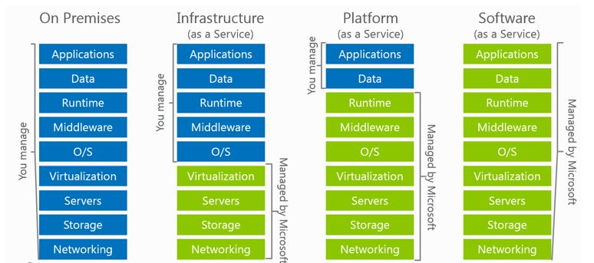
IaaS vs PaaS vs SaaS

Slide 4
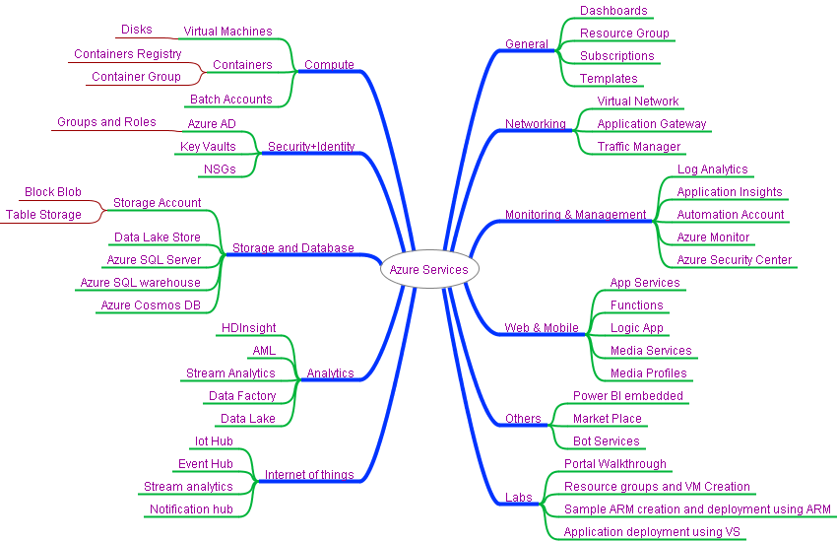
MIND MAP – Azure Services

Slide 5
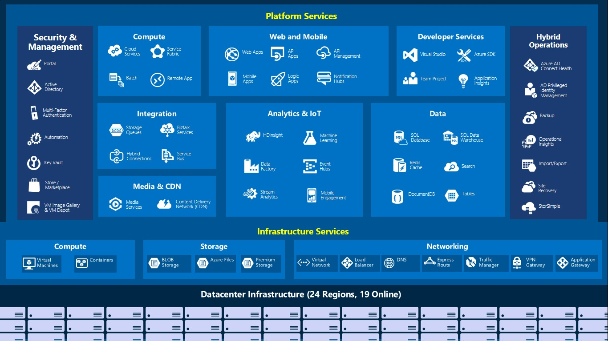
36 GA Regions

Slide 6
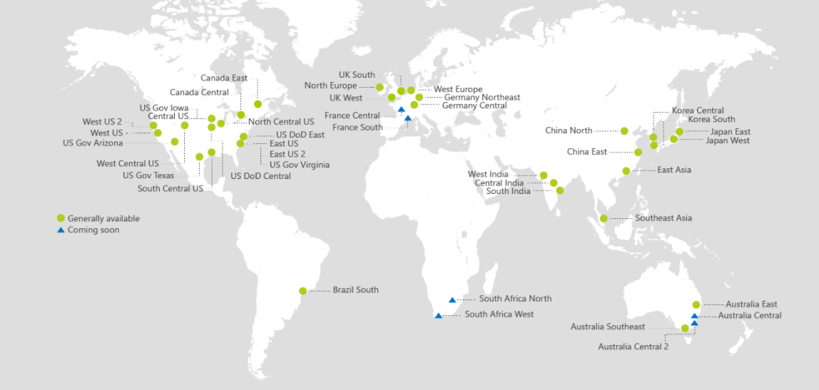
Azure Regions
https://azure.microsoft.com/en-us/regions/

Slide 7
Azure Regional Hierarchy
Cloud
Public Azure
Azure Government
Azure in China operated by 21Vianet
Geo
Jurisdiction
Tax
Data Residency
Region
Customer Proximity
Disaster Isolation
Fault Domain
Fault Isolation

Slide 8
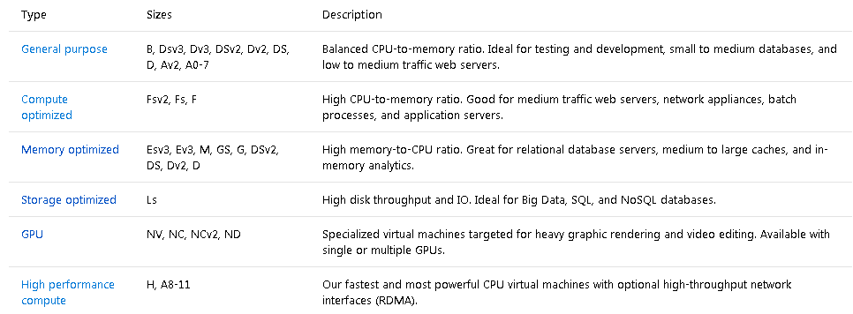
VM Sizes
Determine Cores, RAM, ACUs, Disks, NICs, Network Speed, Temporary Storage, SSD support
High level categories:
https://docs.microsoft.com/en-us/azure/virtual-machines/virtual-machines-windows-sizes

Slide 9
VM Disks
Unmanaged Disks – Requires Azure Storage Container https://docs.microsoft.com/en-us/azure/storage/storage-scalability-targets#unmanaged-virtual-machine-disks
Disks are stored in Page Blob VHD files.
VM disks in an availability set should be in separate storage accounts.
Standard Storage
No performance SLAs
Charged for disk usage, not the size. (If you have provisioned a 100GB disk and are only using 20GB, you pay for 20GB).
Max IOPS per storage account: 20,000 (e.g. 40 disks @ 500 IOPS each)
Premium Storage
Yes performance SLAs
Disk Capacity is 35TB
50 GiB/s for inbound/outbound
Billed for the provisioned amount at the closest tier, rounded up. 100GB disk is charged a P10 rate (128GB), even if it is completely empty.
Managed Disks – Azure manages the disks for you. https://docs.microsoft.com/en-us/azure/storage/storage-managed-disks-overview
No storage account required.
Disks can be exported to Snapshots and downloaded as VHD files.
Isolates disks for VMs in an availability set for increased resiliency.
Standard and Premium as well

Slide 10
VM Disks
Disks can be resized up to 1TB
Disks can be striped to achieve greater IOPS/Storage Size.
VMs can achieve 80,000 IOPS with disk throughput of 2MB/s.
Disk and Azure Storage pricing: https://azure.microsoft.com/en-us/pricing/details/storage/blobs/
Encryption:
IaaS VMs are secured at rest, because you can use industry-standard encryption technology to address organizational security and compliance requirements.
IaaS VMs boot under customer-controlled keys and policies, and you can audit their usage in your key vault.
https://docs.microsoft.com/en-us/azure/security/azure-security-disk-encryption#disk-encryption-deployment-scenarios-and-user-experiences
Disk Caching
None – for Write only and Write heavy (SQL Logs)
ReadOnly – for Read only or read-write disks (SQL Data files)
ReadWrite – for Operating System disks
https://docs.microsoft.com/en-us/azure/storage/storage-premium-storage

Slide 11
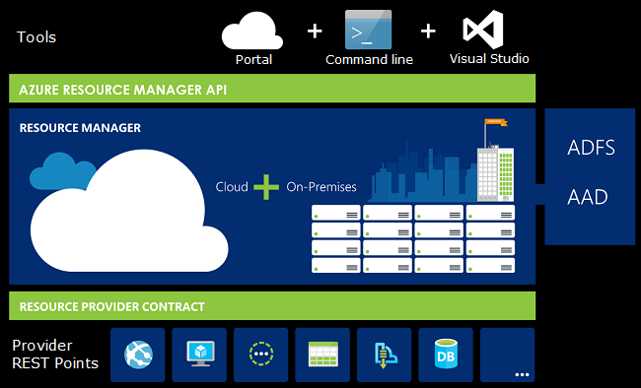
What is ARM?
Resource – Any Azure Service
Resource Group – A container for Azure Resources. Resources only belong to one group. You can grant permissions to users/groups on all resources in a group.
Resource Provider – Service that supplies the resources you can deploy.
Resource Manager Template – a JSON file that defines one more resources deployed to a group and relationships between them.

Slide 12
Author ARM Templates -
JSON Document
Structure
Functions
Nesting
Dependencies
Multiple Resources (Loops)
Advanced Topics

Slide 13
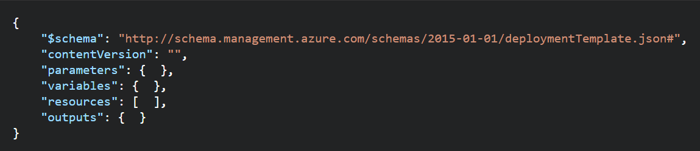
ARM Templates - Structure
Element name | Required | Description
$schema | Yes | Location of the JSON schema file that describes the version of the template language. Use the URL shown in the preceding example.
contentVersion | Yes | Version of the template (such as 1.0.0.0). You can provide any value for this element. When deploying resources using the template, this value can be used to make sure that the right template is being used.
parameters | No | Values that are provided when deployment is executed to customize resource deployment.
variables | No | Values that are used as JSON fragments in the template to simplify template language expressions.
resources | Yes | Resource types that are deployed or updated in a resource group.
outputs | No | Values that are returned after deployment.

Slide 14
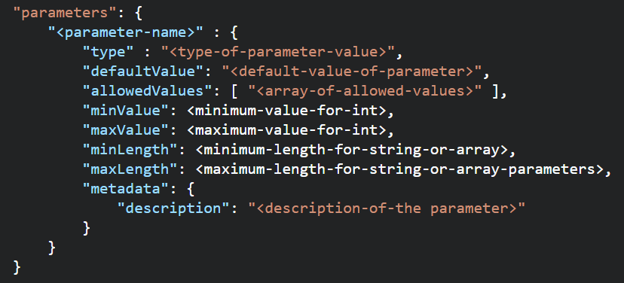
ARM Templates - Parameters
Allowed Types
string
secureString
int
bool
object
secureObject
array
Element name | Required | Description
parameterName | Yes | Name of the parameter. Must be a valid JavaScript identifier.
type | Yes | Type of the parameter value. See the list of allowed types after this table.
defaultValue | No | Default value for the parameter, if no value is provided for the parameter.
allowedValues | No | Array of allowed values for the parameter to make sure that the right value is provided.
minValue | No | The minimum value for int type parameters, this value is inclusive.
maxValue | No | The maximum value for int type parameters, this value is inclusive.
minLength | No | The minimum length for string, secureString, and array type parameters, this value is inclusive.
maxLength | No | The maximum length for string, secureString, and array type parameters, this value is inclusive.
description | No | Description of the parameter that is displayed to users through the portal.

Slide 15
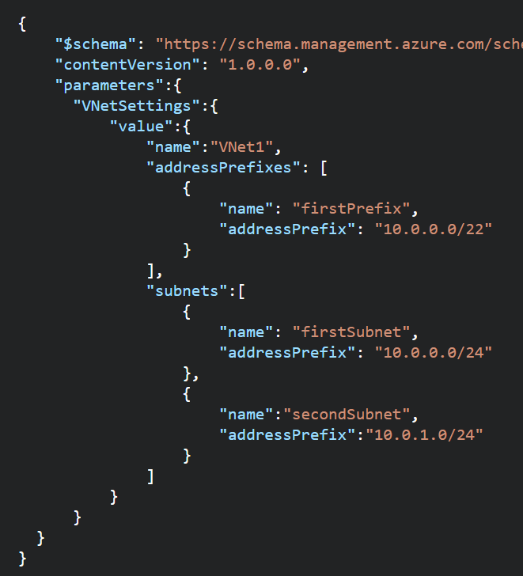
ARM Templates – Parameters
Use Parameters for
Template Reusability
Settings that you want to use variations of according to environment (SKU, size, capacity).
Resource names that you want to specify for easy identification.
Values that you use frequently to complete other tasks (such as an admin user name).
Secrets (such as passwords).
The number or array of values to use when you create multiple instances of a resource type.
Use SecureString type for Passwords
Use default values (except for passwords or secrets)
Only 255 parameters per Template
Parameters can also be passed as Objects
https://docs.microsoft.com/en-us/azure/azure-resource-manager/resource-manager-template-best-practices#parameters

Slide 16
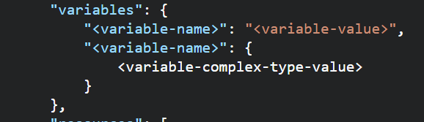
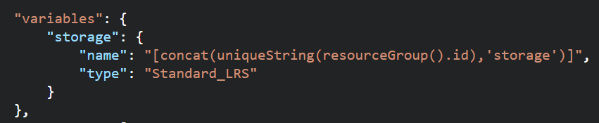
ARM Templates –Variables
Use Variables for
Use variables for values that you need to use more than once in a template.
Include variables for resource names that must be unique.
Use variables for extra manipulation of parameters
You can group variables into complex objects. Use the variable.subentry format to reference a value from a complex object.
https://docs.microsoft.com/en-us/azure/azure-resource-manager/resource-manager-template-best-practices#variables

Slide 17
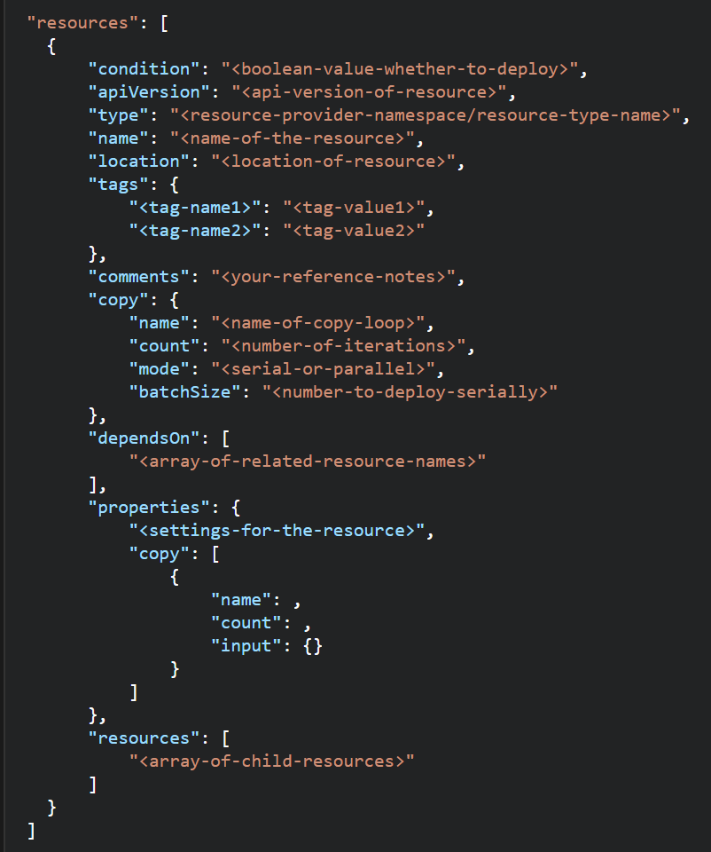
ARM Templates -Resources
When building resources:
This section can get complicated because every resource type has different properties
Use comments to describe what the resource is for.
Use tags for organizing resources
Don’t assign a public IP to a VM in the template if you don’t plan to access it directly. You can always create a public IP later if you need to login. Or, use a Load balancer NAT rule.
Some resource names must be GLOBALLY unique
You can use the uniqueString() function, a meaningful prefix, and other parameters to create names that are unique for the resource group or subscription. Globally unique is not guaranteed.
https://docs.microsoft.com/en-us/azure/azure-resource-manager/resource-manager-template-best-practices#resources

Slide 18
ARM Templates -Resources
Element name | Required | Description
condition | No | Boolean value that indicates whether the resource is deployed.
apiVersion | Yes | Version of the REST API to use for creating the resource.
type | Yes | Type of the resource. This value is a combination of the namespace of the resource provider and the resource type (such as Microsoft.Storage/storageAccounts).
name | Yes | Name of the resource. The name must follow URI component restrictions defined in RFC3986. In addition, Azure services that expose the resource name to outside parties validate the name to make sure it is not an attempt to spoof another identity.
location | Varies | Supported geo-locations of the provided resource. You can select any of the available locations, but typically it makes sense to pick one that is close to your users. Usually, it also makes sense to place resources that interact with each other in the same region. Most resource types require a location, but some types (such as a role assignment) do not require a location. See Set resource location in Azure Resource Manager templates.
tags | No | Tags that are associated with the resource. See Tag resources in Azure Resource Manager templates.
comments | No | Your notes for documenting the resources in your template
copy | No | If more than one instance is needed, the number of resources to create. The default mode is parallel. Specify serial mode when you do not want all or the resources to deploy at the same time. For more information, see Create multiple instances of resources in Azure Resource Manager.
dependsOn | No | Resources that must be deployed before this resource is deployed. Resource Manager evaluates the dependencies between resources and deploys them in the correct order. When resources are not dependent on each other, they are deployed in parallel. The value can be a comma-separated list of a resource names or resource unique identifiers. Only list resources that are deployed in this template. Resources that are not defined in this template must already exist. Avoid adding unnecessary dependencies as they can slow your deployment and create circular dependencies. For guidance on setting dependencies, see Defining dependencies in Azure Resource Manager templates.
properties | No | Resource-specific configuration settings. The values for the properties are the same as the values you provide in the request body for the REST API operation (PUT method) to create the resource. You can also specify a copy array to create multiple instances of a property. For more information, see Create multiple instances of resources in Azure Resource Manager.
resources | No | Child resources that depend on the resource being defined. Only provide resource types that are permitted by the schema of the parent resource. The fully qualified type of the child resource includes the parent resource type, such as Microsoft.Web/sites/extensions. Dependency on the parent resource is not implied. You must explicitly define that dependency.

Slide 19
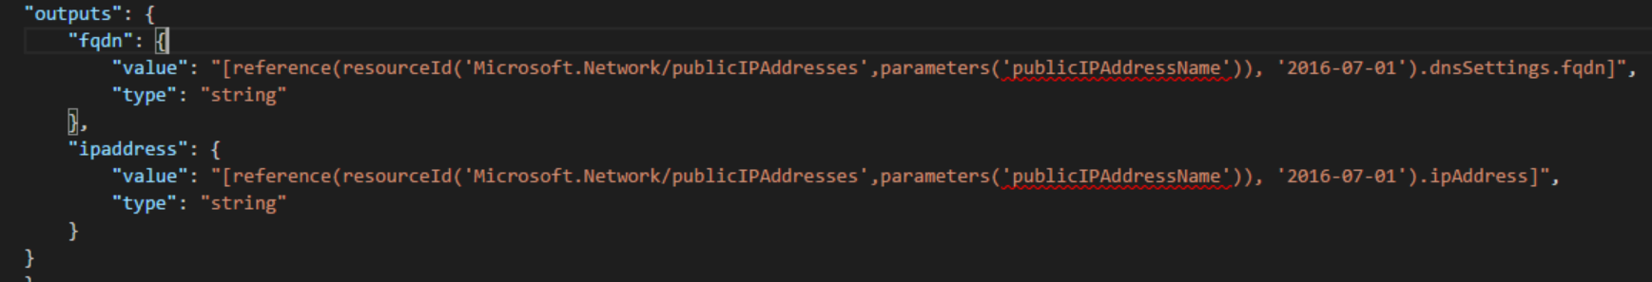
ARM Templates –Outputs
If you use a template to create public IP addresses, include an outputs section that returns details of the IP address and the fully qualified domain name (FQDN). You can use output values to easily retrieve details about public IP addresses and FQDNs after deployment. When you reference the resource, use the API version that you used to create it
Use Outputs to see other values that can’t be determined before the template is created (especially when Unique Ids are generated).
https://docs.microsoft.com/en-us/azure/azure-resource-manager/resource-manager-template-best-practices#outputs

Slide 20
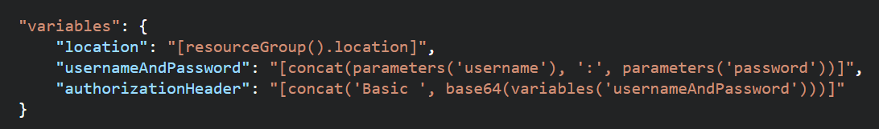
ARM Templates – Functions and Expressions
Templates are JSON
Functions and Expressions extend the JSON capabilities
They let you use some coding notions inside your templates to create or evaluate dynamic values
Functions you see often:
concat – concatenates multiple values
copyIndex – returns the index of an iteration loop
resourceGroup – access properties of this resource group, like the location.
resourceId – get the unique identifier for a resource.
All Functions: https://docs.microsoft.com/en-us/azure/azure-resource-manager/resource-group-template-functions

Slide 21
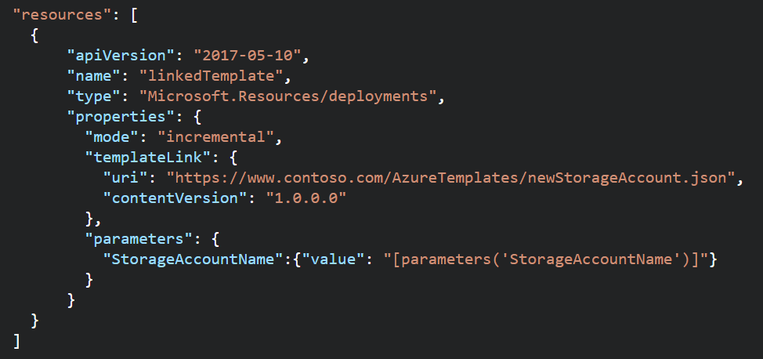

ARM Templates - Nesting
ARM Templates can call other ARM Templates
Create purpose-specific templates
Pass parameters into sub-templates
You can also pass in a parameter file link
Retrieve values out of templates with reference function and outputs
Sub template links must be externally available (but you can use an Azure storage account and SAS token to secure it)
You can provide a link to a template or define a sub template directly inside of a parent template.
Nested templates can be deployed to a different resource group
https://docs.microsoft.com/en-us/azure/azure-resource-manager/resource-group-linked-templates

Slide 22
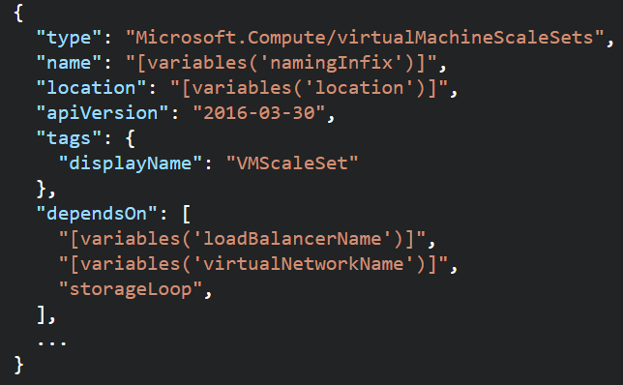
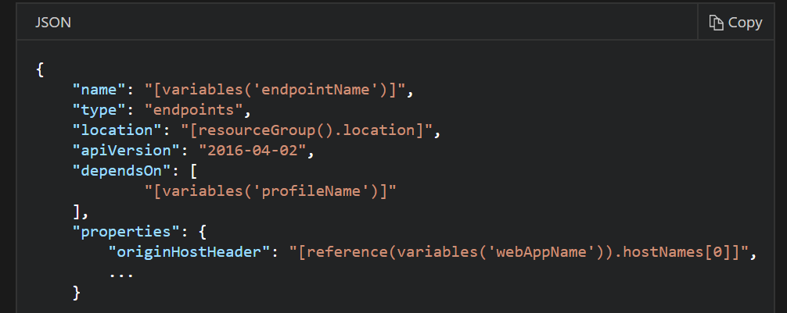
ARM Templates - Dependencies
Resources may require a dependency chain; e.g. You need a VNET before you can deploy a VM.
Use “dependsOn” property to explicitly build the dependencies between resources. Resources wont get created until their dependencies are created.
Use Child resources. Only certain resources can have child resources.
Use the “reference” function to create an implicit relationship. Resources that reference another resource are created after the referenced resource.
https://docs.microsoft.com/en-us/azure/azure-resource-manager/resource-group-define-dependencies

Slide 23
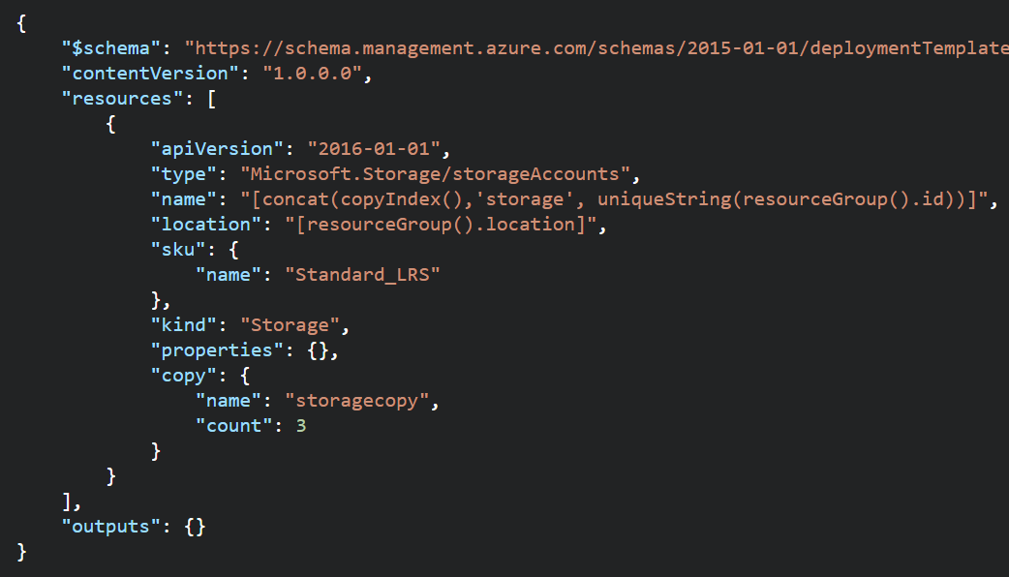
ARM Templates – Multiple Instances
You can create multiple instances in parallel of a resource.
Use the “copy” property to indicate the # of instances
Can be used with length() function on Array to iterate through the collection.
Use the “copyIndex()” function to get the current iteration.
Use it to name resources uniquely.
0 based, but can accept an offset (copyIndex(1))
To create multiple instances of a property (e.g. data disks for a VM), use “copy” property as an array with the name of the property you want multiple instances of (see docs)
You can create dependencies on the copy loops (e.g. Wait for 3 storage accounts to be created, then create a VM).
https://docs.microsoft.com/en-us/azure/azure-resource-manager/resource-group-create-multiple

Slide 24
ARM Templates Advanced Topics
Creating and Updating Resources in one ARM Template based deployment: https://docs.microsoft.com/en-us/azure/azure-resource-manager/resource-manager-update
Share state between linked templates: https://docs.microsoft.com/en-us/azure/azure-resource-manager/best-practices-resource-manager-state
Patterns for deploying resources: https://docs.microsoft.com/en-us/azure/azure-resource-manager/best-practices-resource-manager-design-templates

Slide 25
Deploy Templates

Slide 26
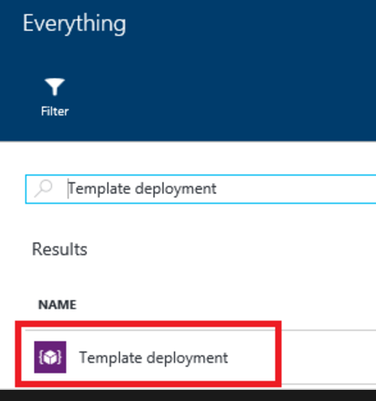
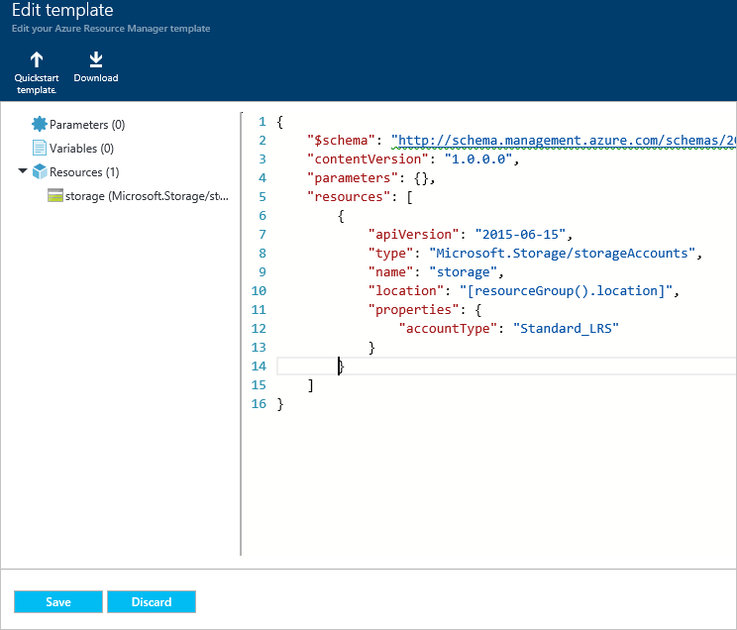
Deploy Templates – Portal, Custom Template

Slide 27
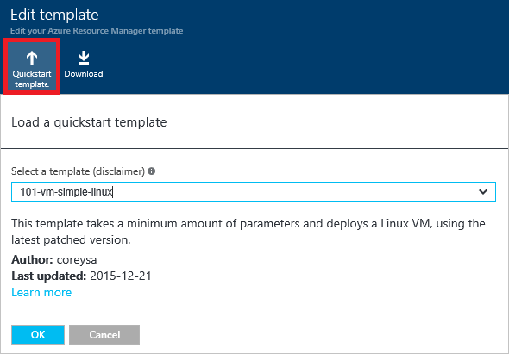
Deploy Templates – Portal, Quickstart

Slide 28
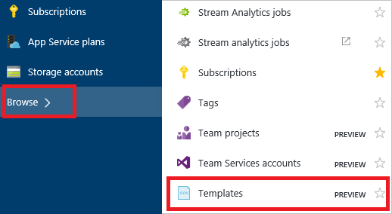
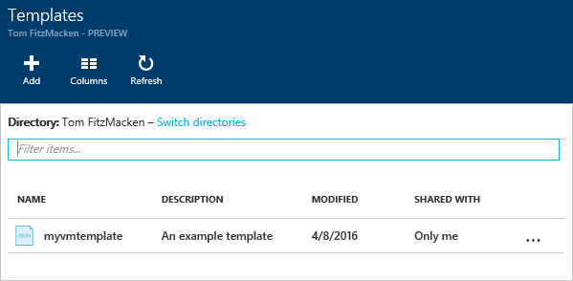
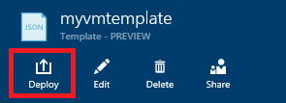
Deploy Templates – Portal, from Account

Slide 29
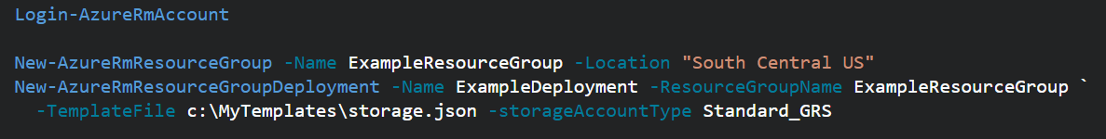
Deploy Templates - Powershell
Deploy a Template from a local json file
Deploy a Template from an external source:
Pass in a local parameter file:
Pass in an external parameter file

Slide 30
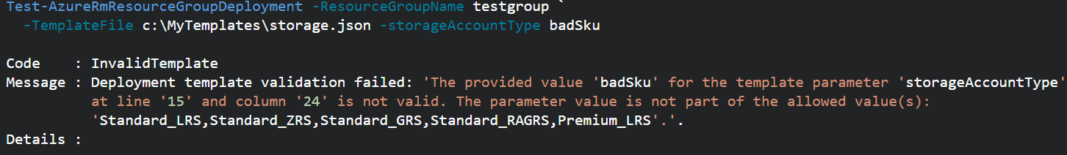
Deploy Templates - PowerShell
You can pass in parameters inline and with a local parameter file.
You CANNOT pass in parameters inline and with an external parameter file.
You can TEST a deployment before running it.
Template Deployments have 2 modes: INCREMENTAL or COMPLETE
Both modes deploy resources defined in Template.
Complete Deployment DELETES resources in group not defined in Template
Incremental does not DELETE resources not defined in Template
Use “-Mode” argument to set Mode.
https://docs.microsoft.com/en-us/azure/azure-resource-manager/resource-group-template-deploy

Slide 31
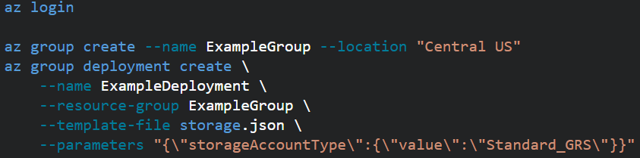

Deploy Templates – CLI (similar to PowerShell)
(You can now get the CLI directly in the Azure Portal! This is makes it super easy to use. Go to the portal and click this button in the top right nav bar: )
Local template file deploy:
External template file deploy, use --template-uri
To use a local parameter file, use @file.path with the --parameters argument.
External parameter files aren’t supported.
You can validate the template deployment. Use “az group deployment validate” and same arguments
Switch between Complete and Incremental mode, use --mode argument.
https://docs.microsoft.com/en-us/azure/azure-resource-manager/resource-group-template-deploy-cli

Slide 32
Regional Availability

Slide 33
Regional Availability - Regions
An Azure Region is a geographic region that contains a collection of data centers.
It’s more than one building.
There are over 30 Azure regions: https://azure.microsoft.com/en-us/regions/
Special / Sovereign Regions:
US Gov Virginia/Iowa
China East, China North
Germany Central, Gemany Northeast
Region Pairs
In same geography (such as US, Europe or Asia)
Replicated resources are replicated across pairs
In broad geographic outage, one region in the pair is prioritized
Data resides in the same geography as its pair (except Brazil South)
Pairs: https://docs.microsoft.com/en-us/azure/best-practices-availability-paired-regions#what-are-paired-regions
Azure Storage GRS and RA-GRS replicates data from one region to its pair.

Slide 34
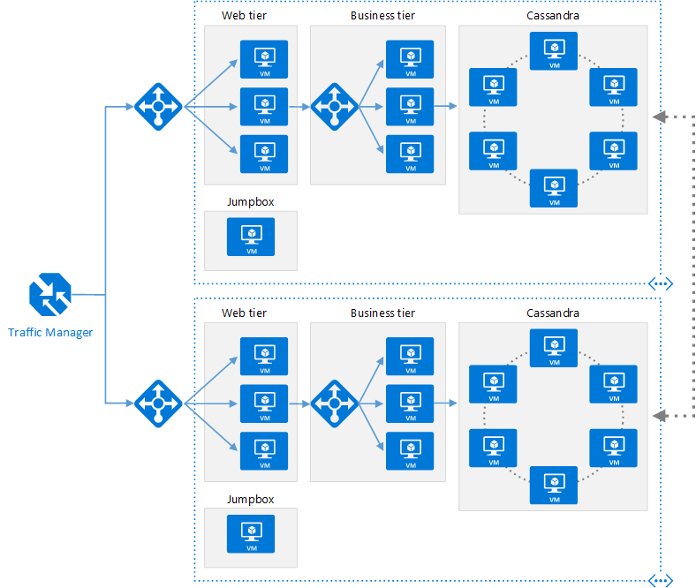
Regional Availability - Design
Primary/Secondary Region for Higher Availability
Traffic Manager routes requests
Put Primary, Secondary and Traffic Manager is separate regions
Make sure each region’s VNET IP range does not overlap
The same ARM template can be deployed, with minor parameter changes for VNET IP address space, and Resource locations.

Slide 35
Regional Availability - Design
Configurations
Active/passive with hot standby (rec)
Active/passive with cold standby
Active/active
Use Regional Pairing
In broad outage, one region from pair is prioritized
Data residency issues mitigated
Traffic Manager
routing = priority,
health probe = write a custom service that reports accurately
Read Reference Architecture Here.
https://docs.microsoft.com/en-us/azure/architecture/reference-architectures/virtual-machines-linux/multi-region-application

Slide 36
High Availability
Availability within a region vs. Regional Availability
Azure Storage makes 3 copies of data within a region (including VM disks)
Use Availability Sets
Design loosely coupled service with asynchronous communication. Use Azure Storage queues or Azure Sevice Bus for queue-centric workflow.
Fault Detection and Retry Logic within your application
Circuit Breaker Pattern
Immutable Infrastructure, Infrastructure as Code
https://docs.microsoft.com/en-us/azure/architecture/resiliency/high-availability-azure-applications
https://docs.microsoft.com/en-us/azure/architecture/resiliency/index#designing-for-resiliency

Slide 37
Lab
Deploying Virtual Machines
Overview
In this lab you will extend an ARM template to deploy virtual machines and a load balancer into the infrastructure.
Lab Goals
Deploy "private" virtual machine
Deploy remote virtual machines
Configure remote virtual machines with DSC
Deploy load balancer
Validate the deployment and configuration of all of these resources

Slide 38
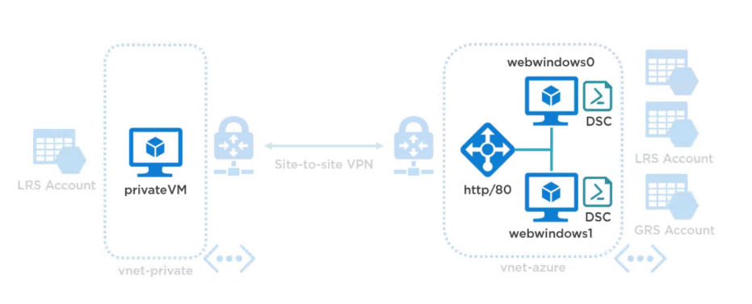
Lab

Slide 39
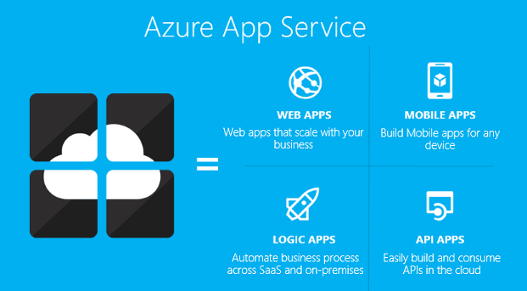
App Service
Authentication
Backup/Restore
Deployment
Networking
Scalability
WebJobs

Slide 40
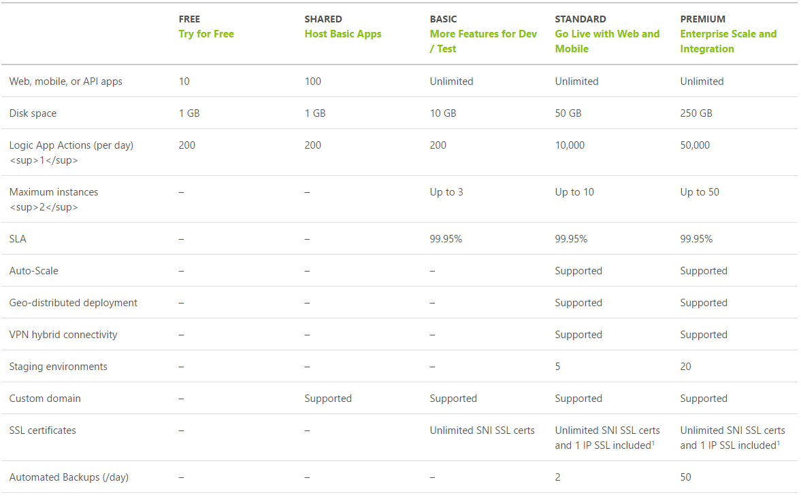
App Service Plan Tiers
https://azure.microsoft.com/en-us/pricing/details/app-service/plans/

Slide 41
App Service Plan
Represents the collection of physical resources used to host your apps
Region (West US, East US, etc.)
Scale count (one, two, three instances, etc.)
Instance size (Small, Medium, Large)
SKU (Free, Shared, Basic, Standard, Premium)
Web Apps, Mobile Apps, API Apps, Functions run in an App Service Plan
Notes:
Create App Service Plans
Azure App Service plans in-depth overview
https://docs.microsoft.com/en-us/azure/app-service/azure-web-sites-web-hosting-plans-in-depth-overview?toc=%2fazure%2fapp-service-web%2ftoc.json

Slide 42
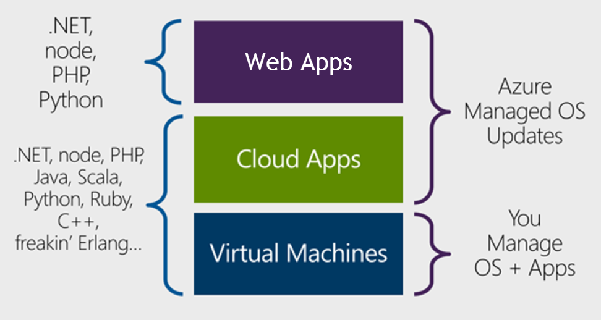
Design Azure App Service Web Apps
Notes:
Design Azure App Service Web Apps
Web Apps overview
https://docs.microsoft.com/en-us/azure/app-service-web/app-service-web-overview
https://docs.microsoft.com/en-us/azure/app-service-web/choose-web-site-cloud-service-vm#scenarios

Slide 43
Design Azure App Service Web Apps
Platform as a Service
Azure Resource Manager (ARM) Technology
Easy to use with existing development skills:
VSTS/Git/GitHub/etc. for deployment Visual Studio integration
Other Azure options for deploying web applications:
Virtual Machines (IaaS)
Service Fabric (Microservice architectures)
Cloud Services (Web Roles and Worker Roles) – Older ASM technology
Notes:
ASM = Azure Service Manager

Slide 44
Design Custom Web API
Web API is a one or more RESTful services (with one or more opereations)
Endpoints expose services to external, partner or internal developers
Can implement in several technologies:
ASP.Net Web API
Node.js
App Service options:
Web App (if you need a web site too)
Mobile App
API App
Notes:
Design Custom Web API
Create a REST service using ASP.NET Web API and SQL Database in Azure App Service
https://docs.microsoft.com/en-us/azure/app-service-web/web-sites-dotnet-rest-service-aspnet-api-sql-database
https://azure.microsoft.com/en-us/services/api-management/

Slide 45




4 Major Security Pillars
Identity & Access
Network Security
Storage Security
Application Security

Slide 46
Identity & Access Management
AZURE:
Uses Azure AD to govern access to the management portal with granular access controls for users and groups on subscription or resource groups
Provides enterprise cloud identity and access management for end users
Enables single sign-on across cloud applications
Offers Multi-Factor Authentication for enhanced security
CUSTOMER:
Centrally manages users and access to Azure, O365, and hundreds of pre-integrated cloud applications
Builds Azure AD into their web and mobile applications
Can extend on-premises directories to Azure AD
Azure
Active Directory
Cloud Apps
End Users & Administrators
Active Directory

Slide 47
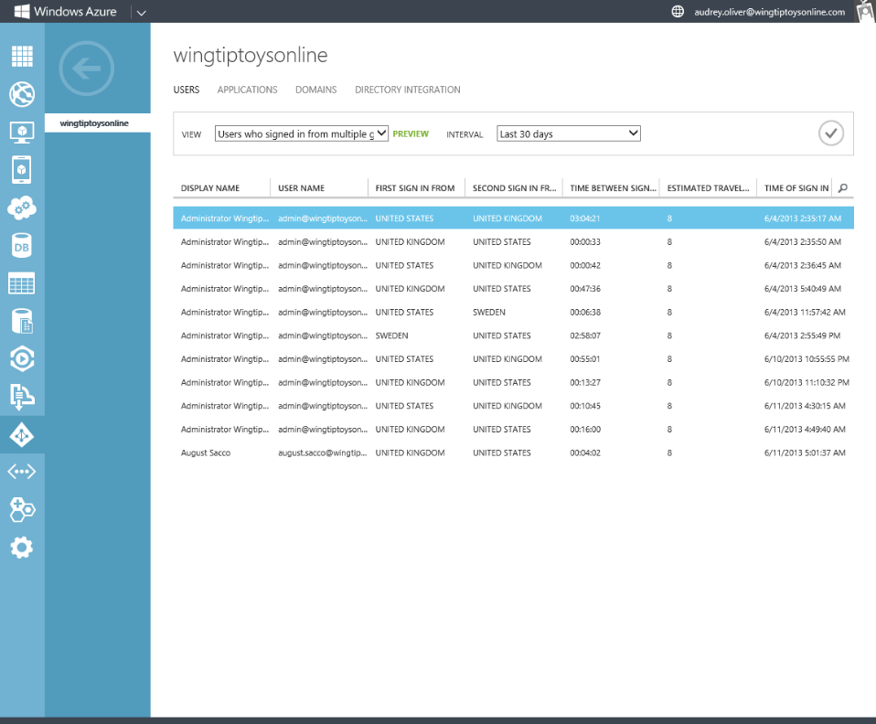
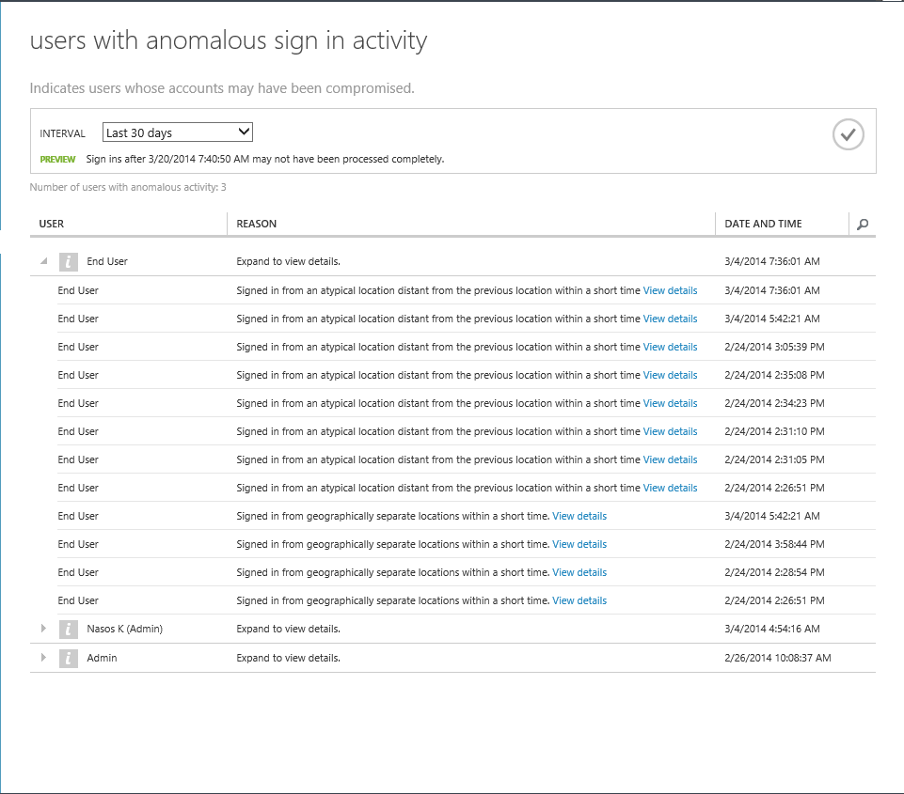
Access security & monitoring
AZURE:
Uses password hashes for synchronization
Offers security reporting that tracks inconsistent traffic patterns, including:
Sign ins from unknown sources
Multiple failed sign ins
Sign ins from multiple geographies in short timeframes
Sign ins from suspicious IP addresses and suspicious devices
CUSTOMER:
Reviews reports and mitigates potential threats
Can enable Multi-Factor Authentication
User
Non-user
XXXXX
XXXXX
XXXXX

Slide 48
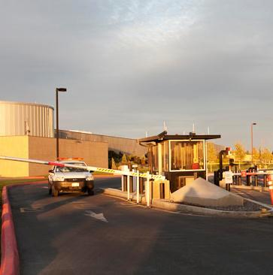
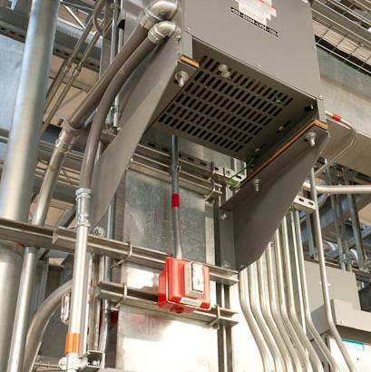
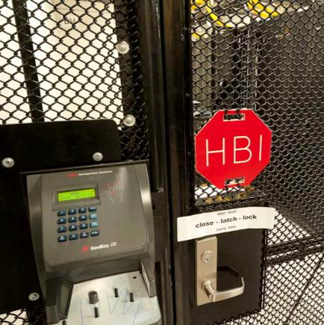
Physical Security
Cameras
24X7 security staff
Barriers
Fencing
Alarms
Two-factor access control: Biometric readers & card readers
Security operations center
Seismic bracing
Days of backup power
Perimeter
Building
Computer room

Slide 49
Network isolation
INTERNET
AZURE:
Does not enable general internet access by default, except remote administration endpoints configured when Virtual Machines are created in the Portal
CUSTOMER:
Configure endpoints for required access
Creates connections to other cloud and on-premises resources
Client
Client
Customer
Admin
Microsoft Azure
Portal
Smart API
Portal
SMAPI
Cloud Access
Layer
Web Endpoint (public access)
RDP Endpoint
(password access)
Customer 1
Customer 2
Deployment X
Deployment X
Deployment Y
VPN
VNET to VNET
Corp 1
Isolated Virtual Network
Isolated Virtual Networks

Slide 50
Virtual networks
AZURE:
Allows customers to create isolated virtual private networks
CUSTOMER:
Creates Virtual Networks with Subnets and Private IP addresses
Enables communications between their Virtual Networks
Can brings their own DNS
Can domain join their Virtual Machines
INTERNET
Client
Microsoft Azure
Cloud Access
RDP Endpoint
(password access)
Customer 1
Customer 2
Subnet 1
Subnet 2
Subnet 3
Deployment X
Deployment Y
Corp 1
VPN
VNET to VNET
DNS Server
Isolated Virtual Networks
Isolated Virtual Network

Slide 51


Network Security Groups (NSG)
Grouping of network traffic rules as security group
Security groups associated with virtual machines or virtual subnets
Controlled access between machines in subnets
Controlled access to and from the Internet
Network traffic rules updated independent of virtual machines
Internet
Microsoft Azure
NSG
Front End Subnet
Back End Subnet
NSG
Virtual Network

Slide 52
VPN connections
AZURE:
Enables connection from customer sites and remote workers to Azure Virtual Networks using Site-to-Site and Point-to-Site VPNs
Offers forced tunneling capabilities to enable customers to mandate all internet-bound traffic go through the Site-to-Site tunnel
CUSTOMERS:
Configures the VPN client in Windows
Manages certificates, policies, and user access
Microsoft Azure
Customer 1
Deployment X
Customer Site
Site-to-Site VPN
VPN
Point-to-Site VPN
Computers Behind Firewall
Isolated Virtual Network
Remote Workers

Slide 53
ExpressRoute connections
Microsoft Azure
AZURE:
Offers private fiber connections via ExpressRoute
Enables access to Compute, Storage, and other Azure services
CUSTOMERS:
Establish connections to Azure at an ExpressRoute location
Directly connect to Azure from an existing WAN network (such as a MPLS VPN) provided by a network service provider
Can now authorize other Azure accounts to use a common ExpressRoute circuit
Manages certificates, policies, and user access
Customer 1
ExpressRoute
Peer
Deployment X
Site 1
WAN
Site 2
Isolated Virtual Network

Slide 54

Encryption in transit
AZURE:
Encrypts most communication between Azure datacenters
Encrypts transactions through Azure Portal using HTTPS
Supports FIPS 140-2
CUSTOMER:
Can choose HTTPS for REST API (recommended)
Configures HTTPS endpoints for application running in Azure
Encrypts traffic between Web client and server by implementing TLS on IIS
Azure
Data Center
Azure
Portal
Azure
Data Center

Slide 55



Encryption at rest
Virtual Machines:
Data drives – full disk encryption using BitLocker
Boot drives – BitLocker and partner solutions
SQL Server – Transparent Data and Column Level Encryption
Files & folders - EFS in Windows Server
Storage:
Bitlocker encryption of drives using Azure Import/Export service
Blob encryption
Applications:
Client Side encryption through .NET Crypto API
SDK for file encryption by your applications
Virtual Machines
SQL TDE
Bitlocker
Partners
EFS
Storage
Bitlocker
StorSimple
Applications
.NET Crypto
RMS SDK

Slide 56
Data segregation
End
Users
Storage isolation:
Access is through Storage account keys and Shared Access Signature (SAS) keys
Storage blocks are hashed by the hypervisor to separate accounts
SQL isolation:
SQL Database isolates separate databases using SQL accounts
Network isolation:
VM switch at the host level blocks inter-tenant communication
Microsoft Azure
Customer
Admin
Portal
SMAPI
Customer 1
Customer 2
Guest VM
Guest VM
Guest VM
Fabric
Controller
Hypervisor
Host OS
Azure Storage
Access
Control
SQL Database

